Slide 1
Synthesis of freestanding single-crystal perovskite films and heterostructures
1601210123
李鑫
导师：韩景智

Slide 2
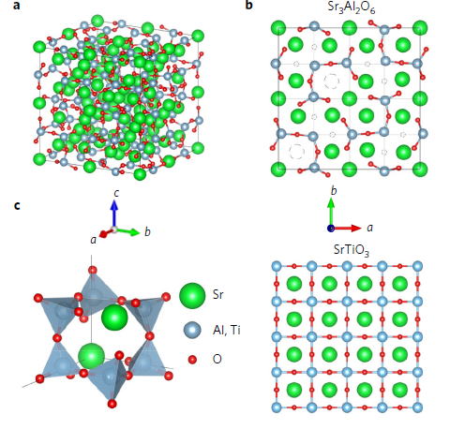
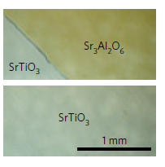
a, Cubic
lattice structure of Sr3Al2O6. b, (Top) Top 1/4 of the Sr3Al2O6 unit cell
projected onto the (001) plane. Dashed circles indicate vacancy sites.
(Bottom) 4_x0002_4 unit cells of the SrTiO3 crystal structure projected onto the
(001) plane. c, Al6O18
18􀀀 rings in Sr3Al2O6 consisting of AlO4 tetrahedra.

Slide 3
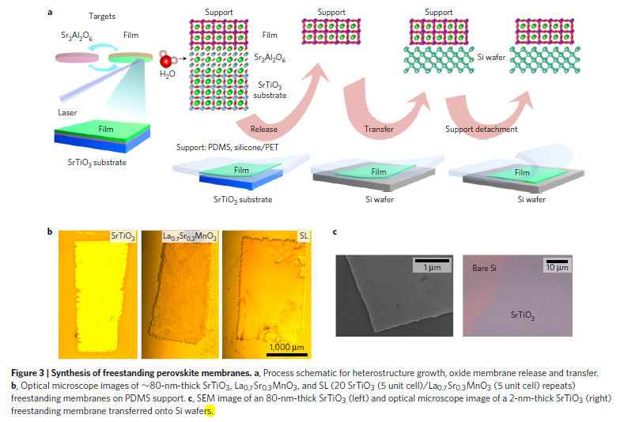

Slide 4
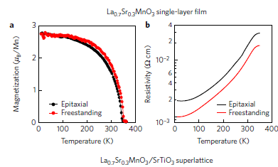
freestanding membranes of oxide single crystals and heterostructures offer a unique opportunity to combine thin film heterostructure approaches with semiconductor device architectures32, flexible electronics33, and the growing family of exfoliated 2D materials.

Slide 5
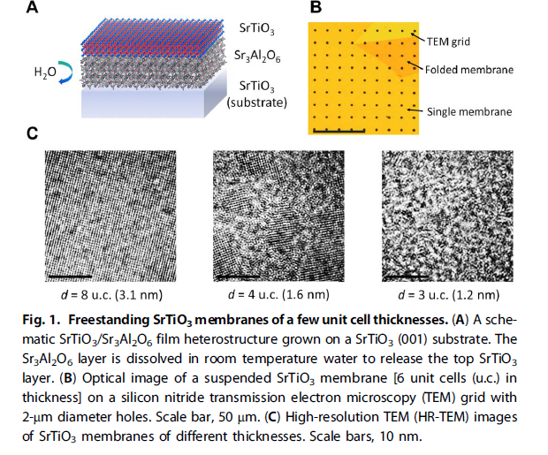

Slide 6
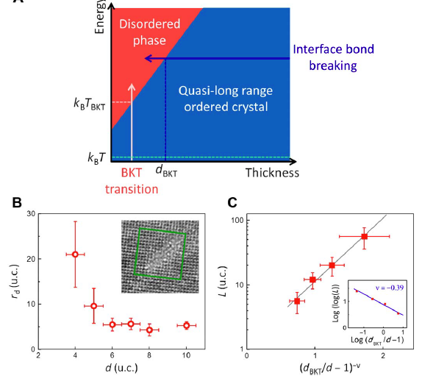

Slide 7
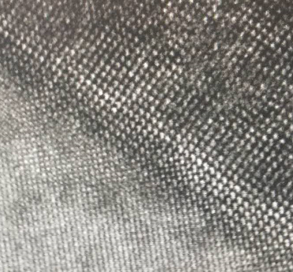
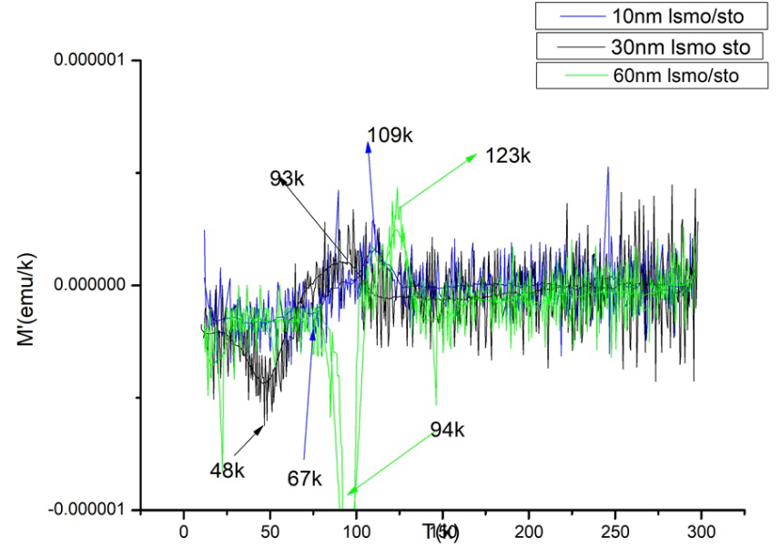
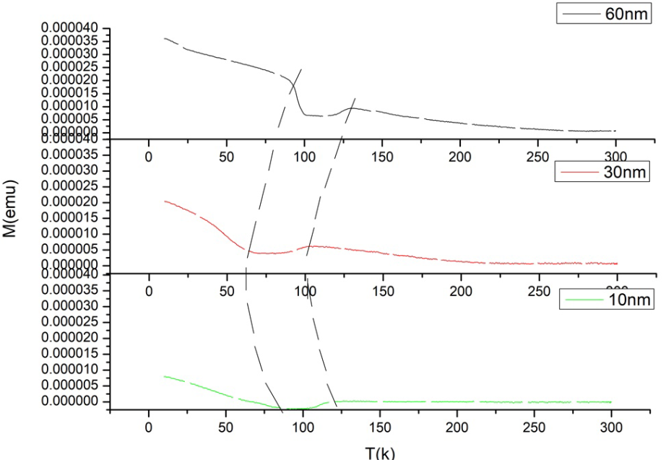
现在的工作

